Slide 1
慕光英文書院
STEM - 不同顏色的溫度(20210216)

Slide 2
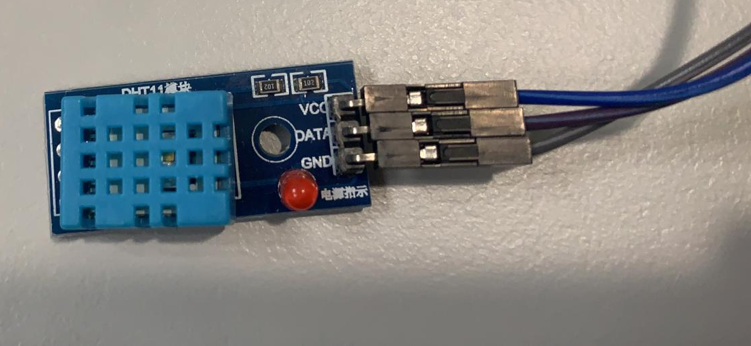
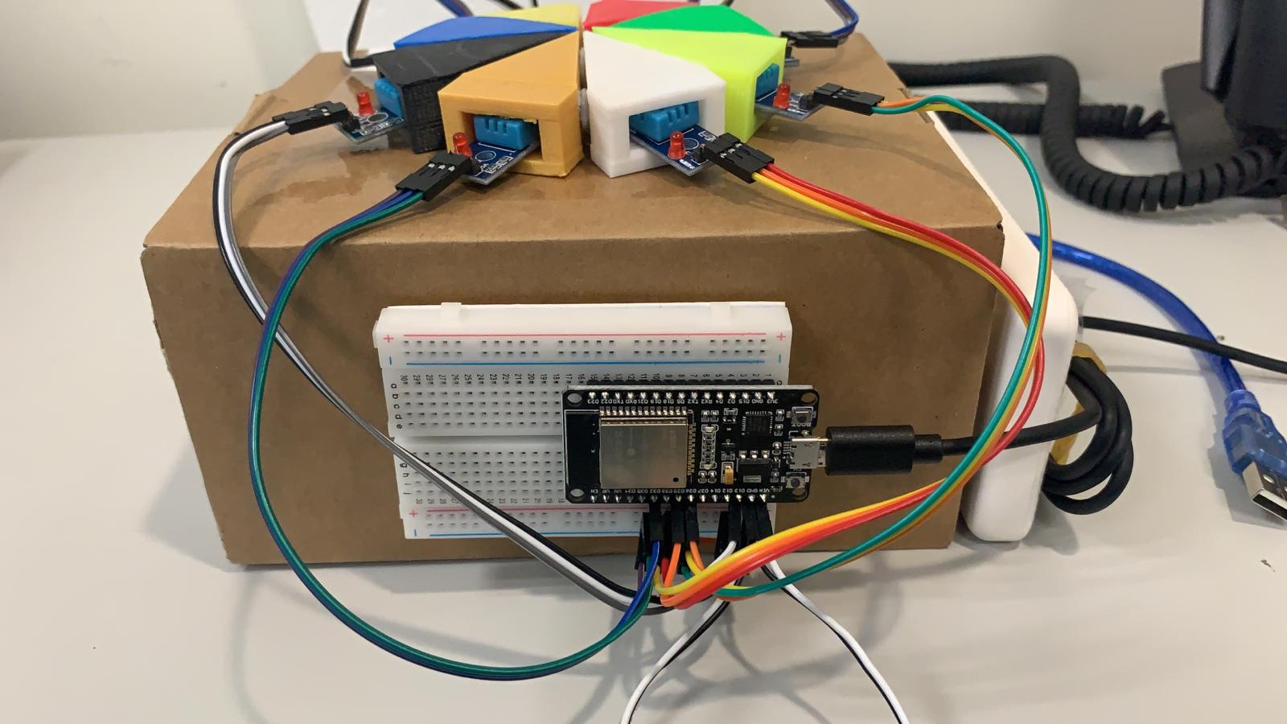
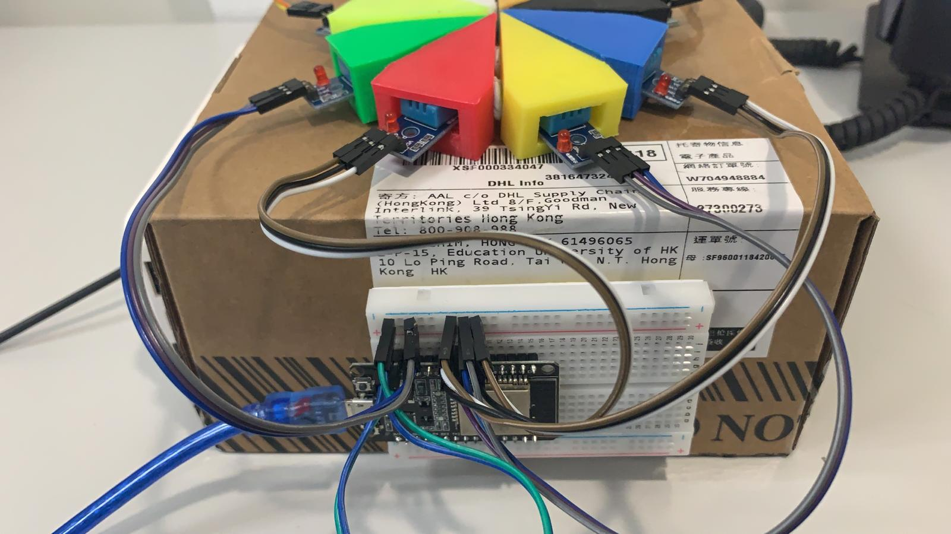
DHT11
Temperature sensor
ESP32
Wi-Fi & Bluetooth MCU

Slide 3
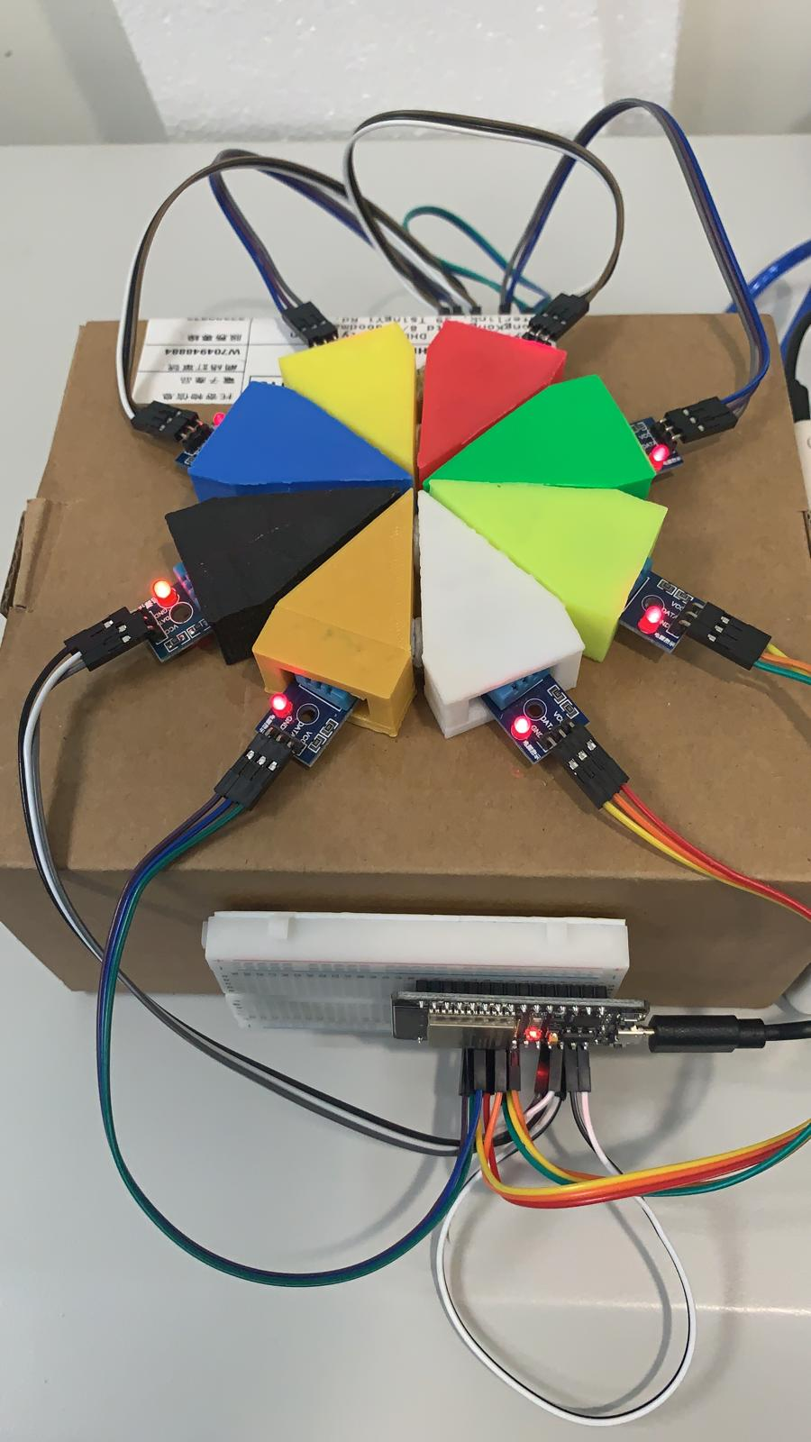
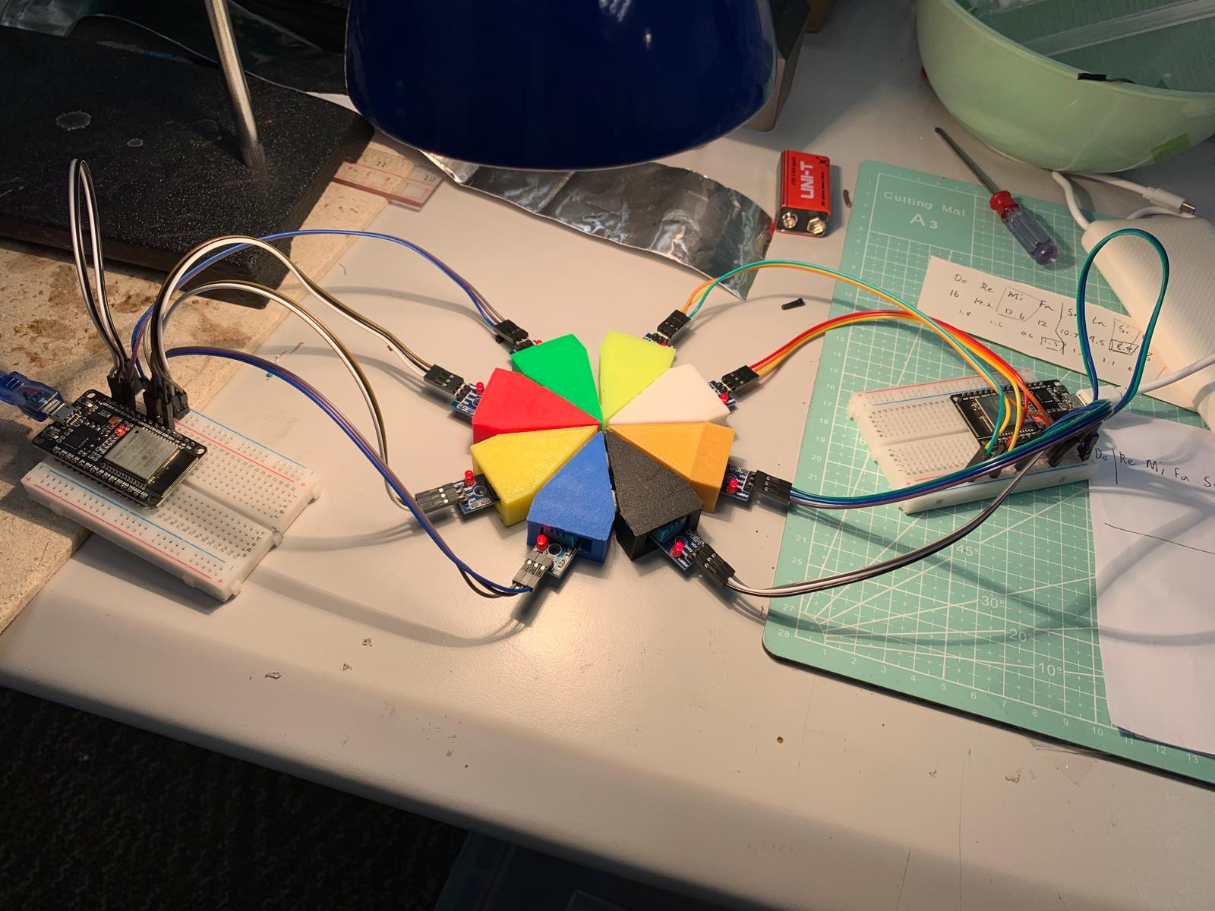

Slide 4
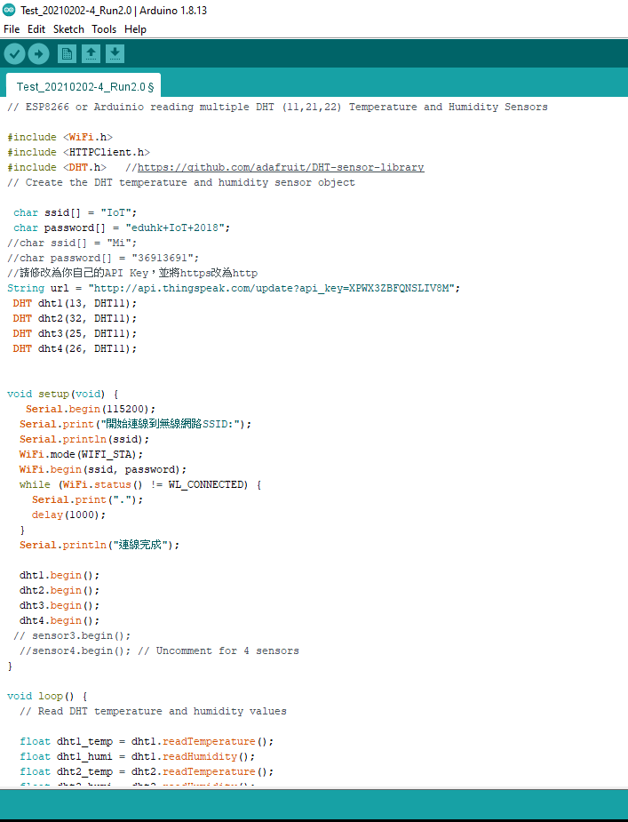
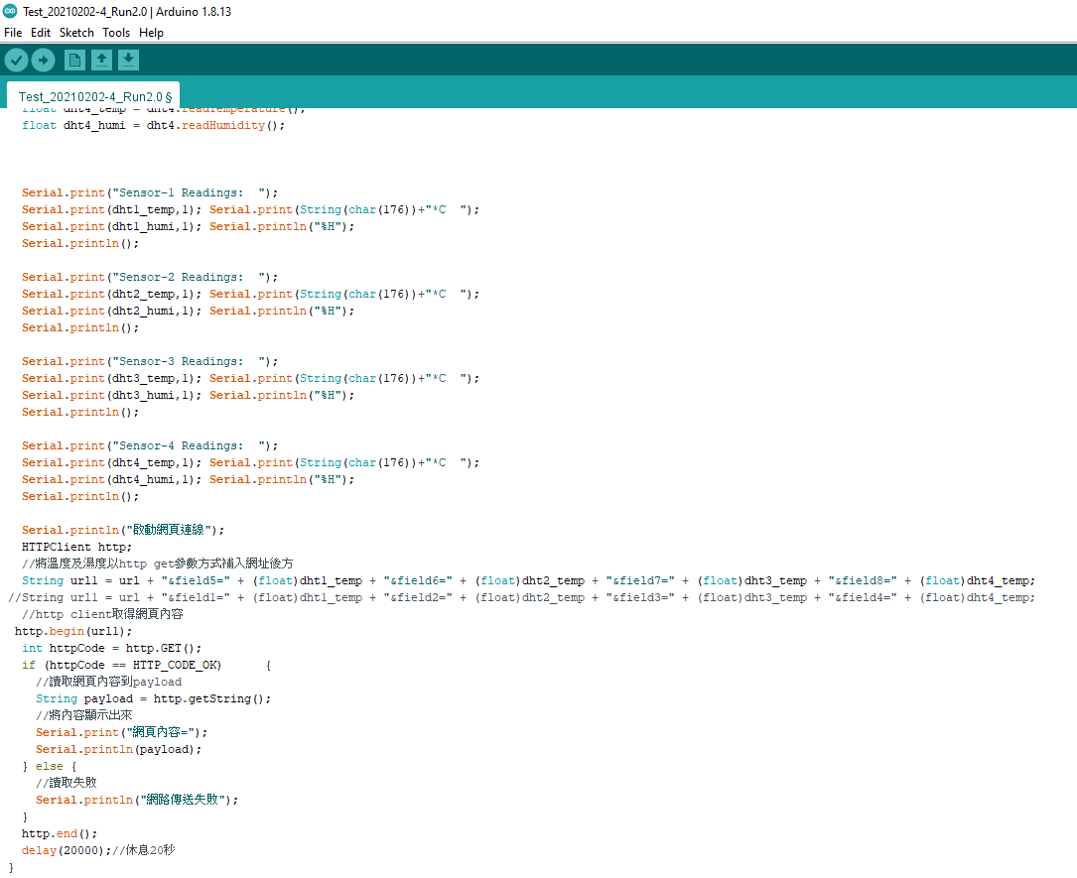

Slide 6
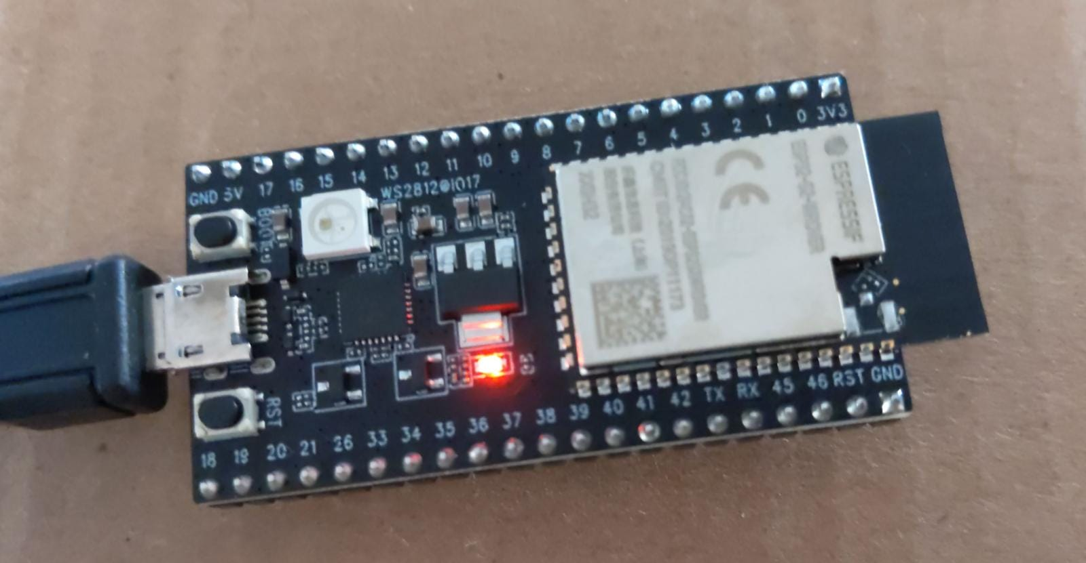
ESP32

Slide 7
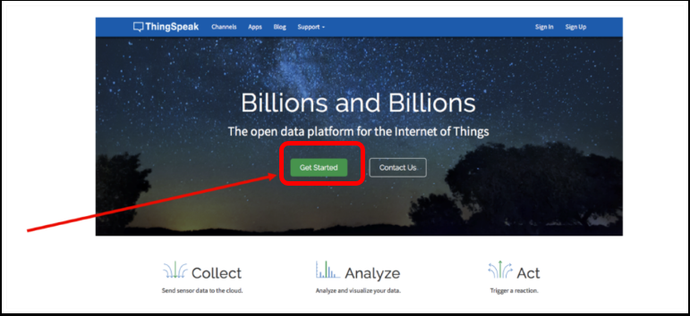
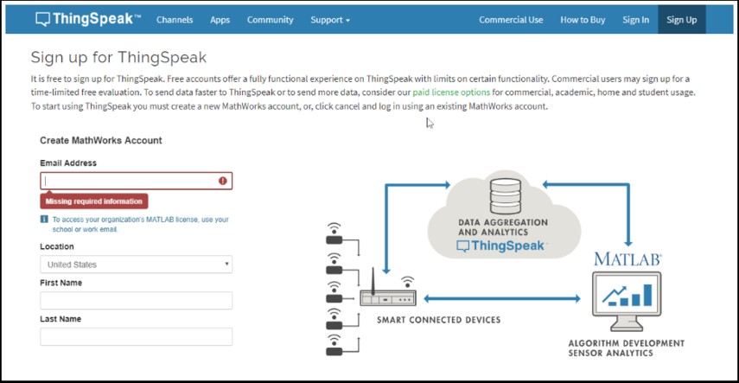
ThingSpeak
Step 1: Sign up in https://thingspeak.com

Slide 8
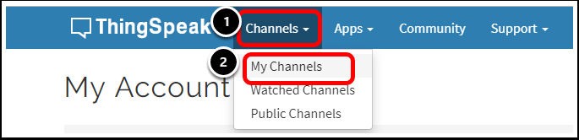
Step 2: login後從網頁上方的Channels選取My Channels

Slide 9
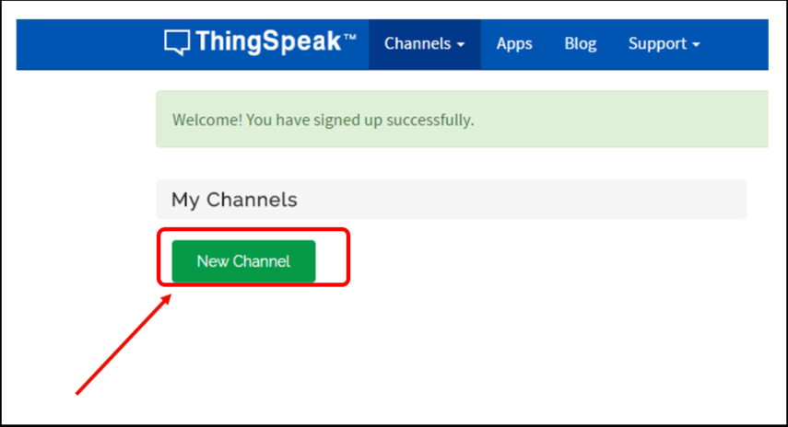
Step 3: 選取New Channel

Slide 10
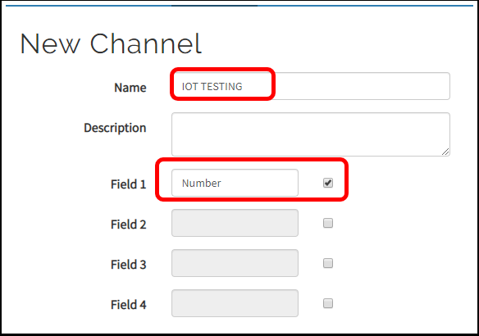
Step 4: 輸入Channel的名字,並加入Field來記錄數據.
“Temperature”

Slide 11
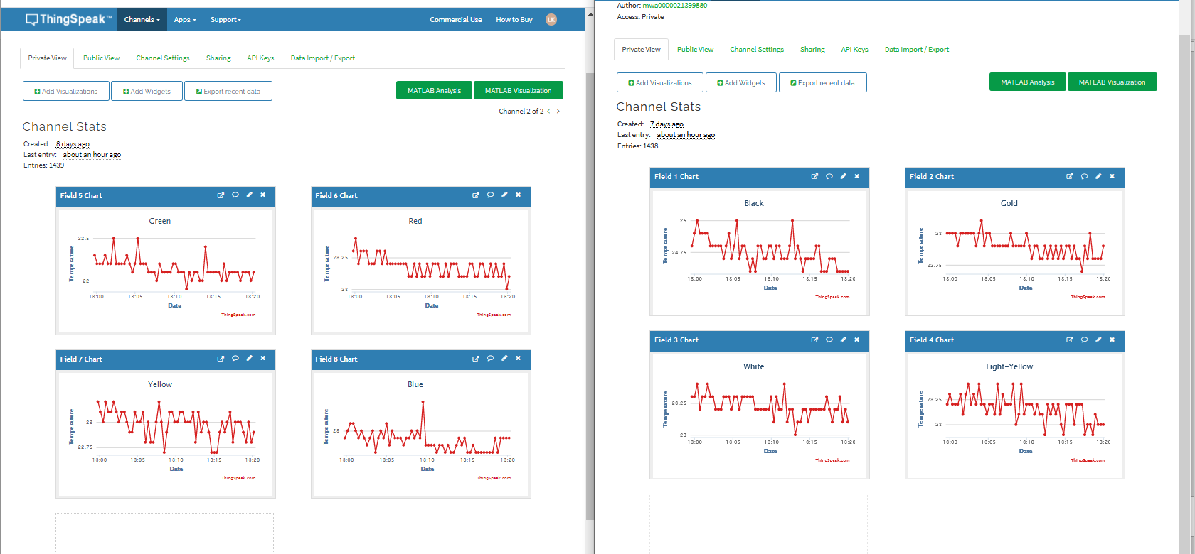
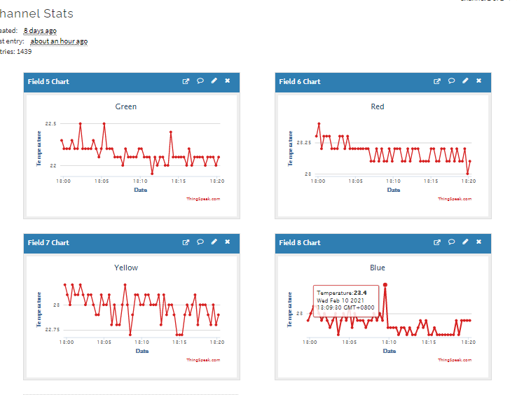

Slide 12
2. Edit(clear data)
3. API Key (Coding)
1.Share
4. Download data(Excel)

Slide 13
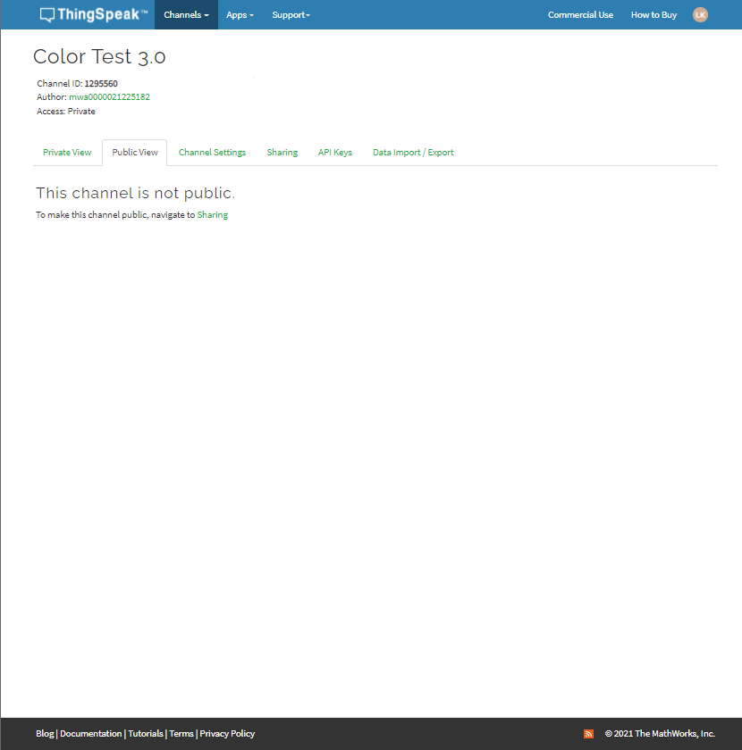
1.Share

Slide 14
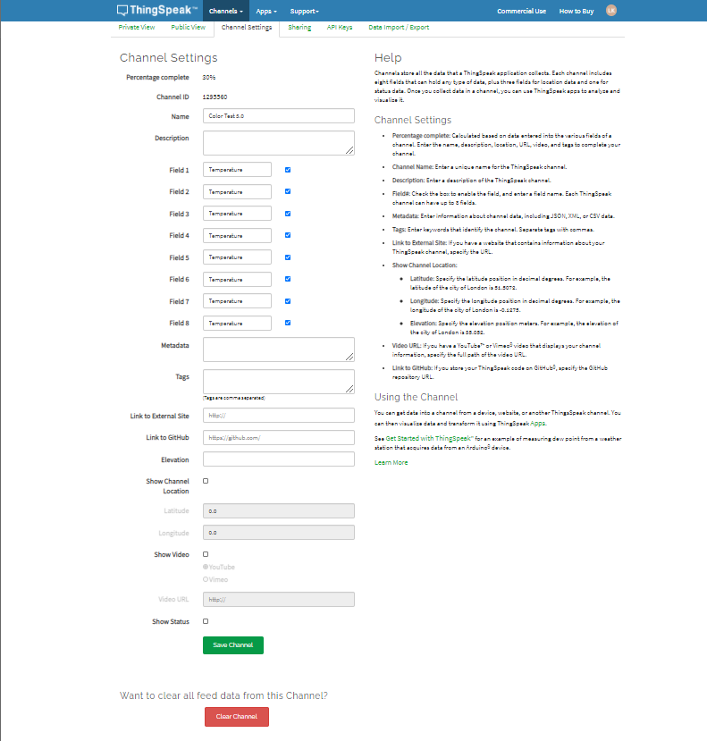
2. Edit(clear data)
Clear Channel

Slide 15
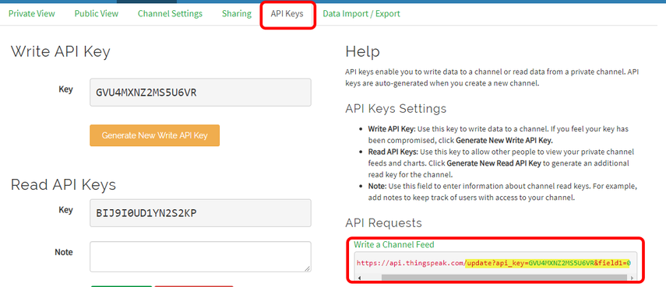
3. API Key (Coding)

Slide 16
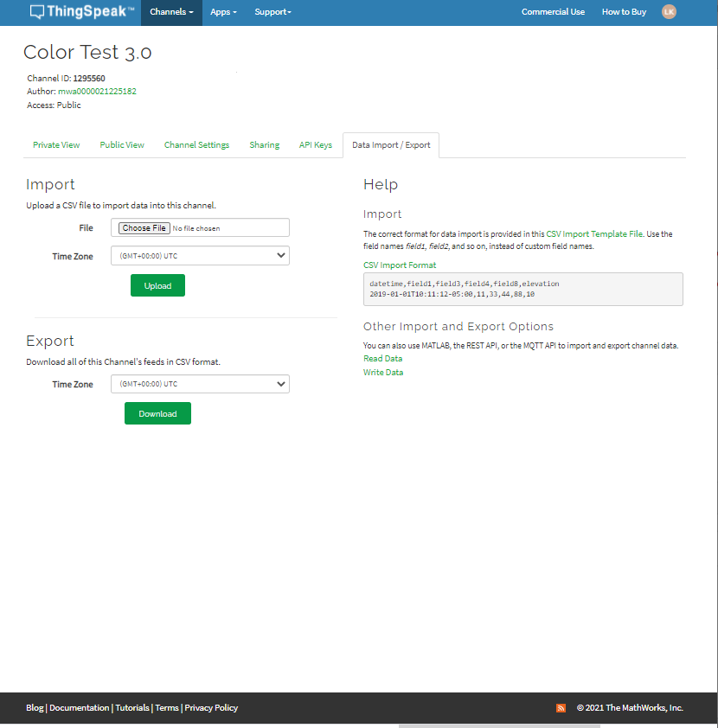
4. Download data(Excel)
*GMT+8:00 – Hong Kong

Slide 17
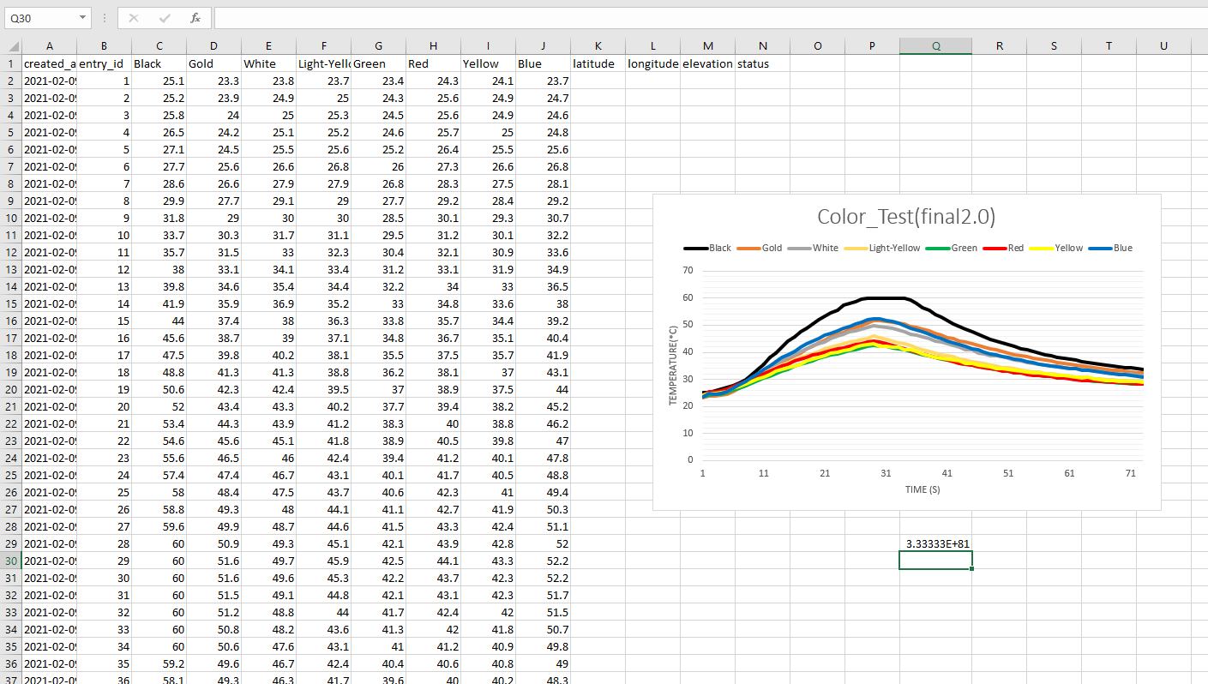
Excel

Slide 18
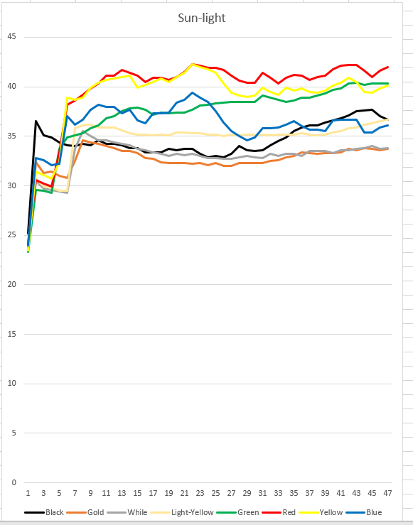
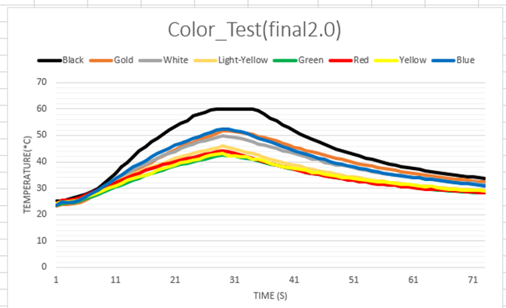
Excel(cont)

Slide 19
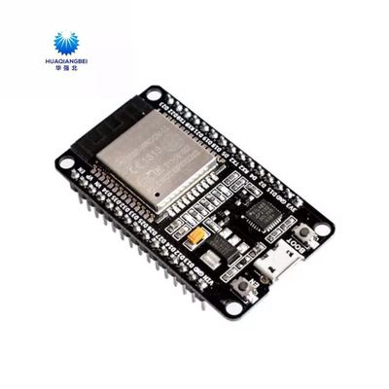
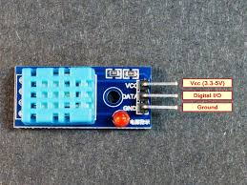
主要所需物料
DHT11 (¥2.5) https://item.taobao.com/item.htm?spm=a230r.1.14.9.76762013wiZLMa&id=623475638592&ns=1&abbucket=3#detail
ESP32 (¥23.8) https://item.taobao.com/item.htm?spm=a230r.1.14.49.fa7764ac3ZE2qD&id=595157763074&ns=1&abbucket=3#detail

