Slide 1

Micro:bit Automatic Sanitizer Dispenser

Slide 2
IR Sensor
Photoresistor
Ultrasonic Sensor

Slide 3
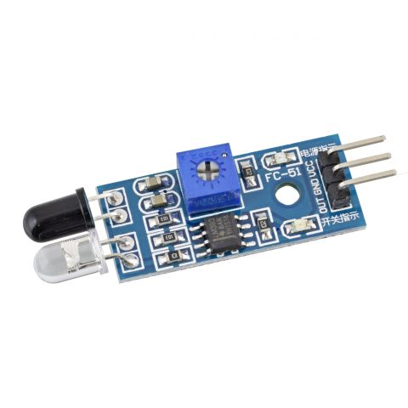
1. IR Sensor
Voltage: 3.3V / 5V
Range: 0 - 15cm
Digital read (0-1)
Pros:
Low energy consumption
Detect motion in daytime and nighttime reliably
Measure distance to soft, thin, small objects which may not be easily detected by ultrasound.
Cons:
May affected by hard objects (e.g. walls, doors) , smoke, dust, etc.
Performance degrades with longer distances.

Slide 4
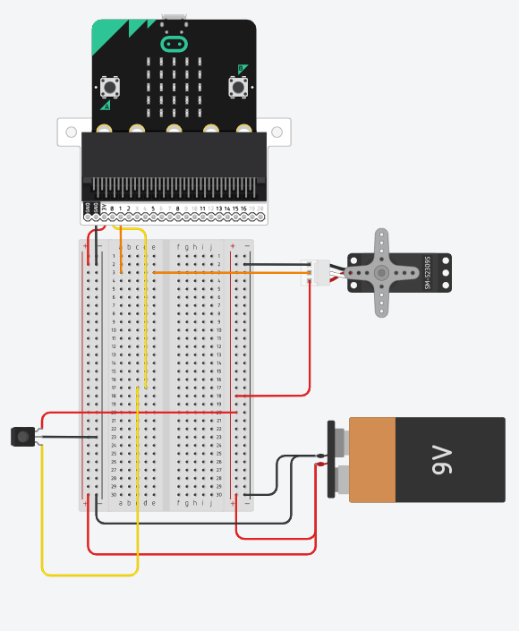
3.3V input
5V input

Slide 5
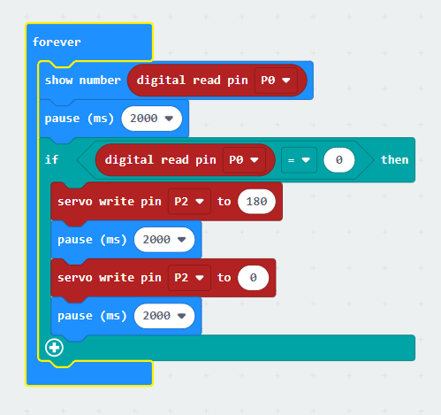

Slide 6
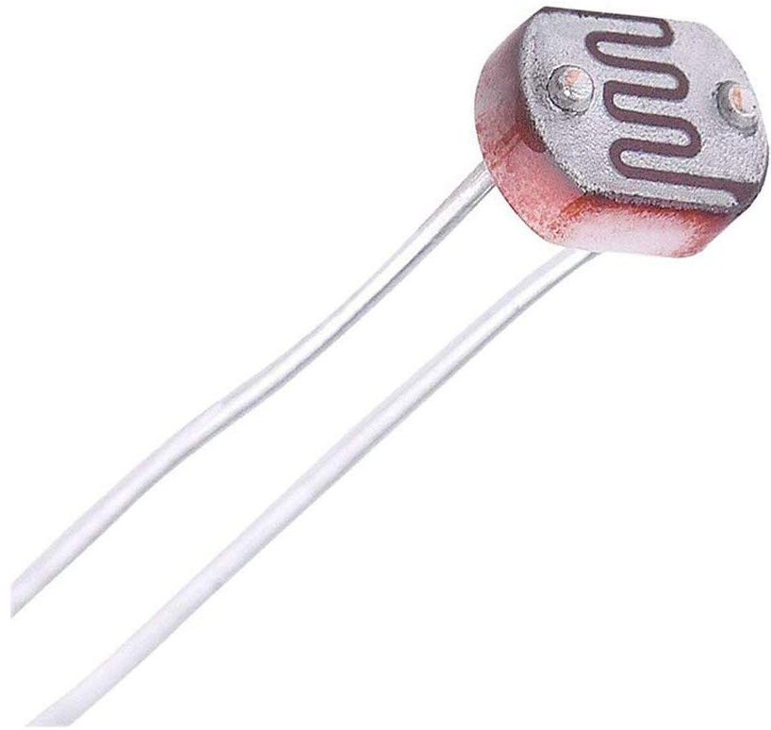
2. Photoresistor
Voltage: 3.3V / 5V
Range: /
Analog read (0 - 1023)
Pros:
Low energy consumption
Cheap and available in various shapes and size
Bi-directional
Cons:
High dependency on the light (Not reliably in nighttime)
Voltage divider are needed

Slide 7
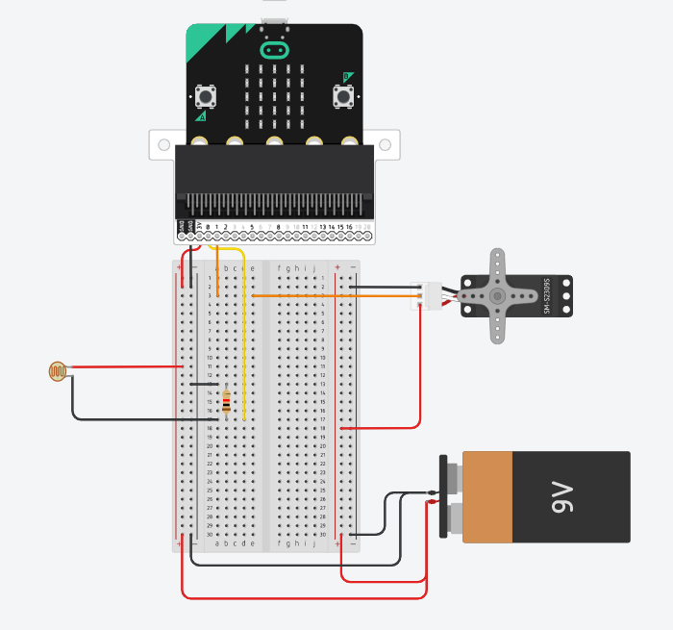
3.3V input
5V input

Slide 8
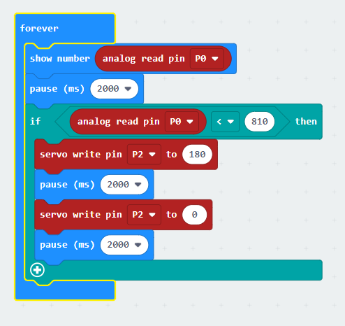

Slide 9
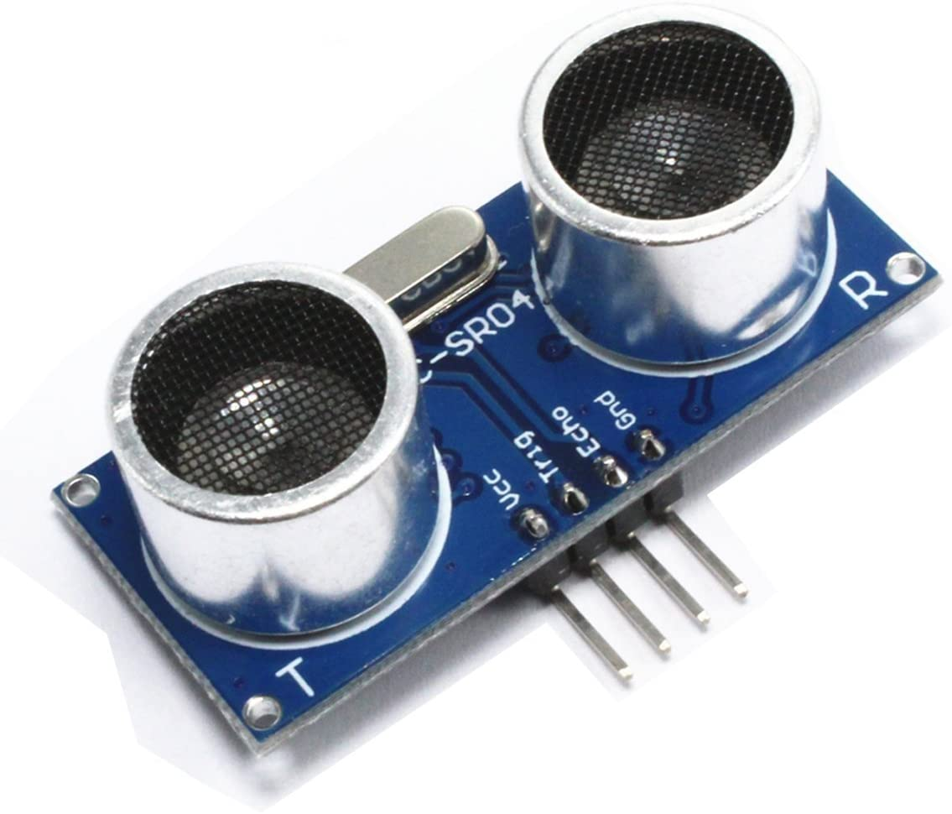
3. Ultrasonic Sensor
Voltage: 3.3V / 5V
Range: 2 – 450 cm
Analog read (0 - 1023)
Pros:
Not affected due to atmospheric dust, rain,etc.
Higher sensing distance
Greater accuracy at measuring thickness and distance to a parallel surface
Cons:
Not working well in 2 cm – 10 cm range
Difficulties in reading reflections from curved, thin and small objects

Slide 10
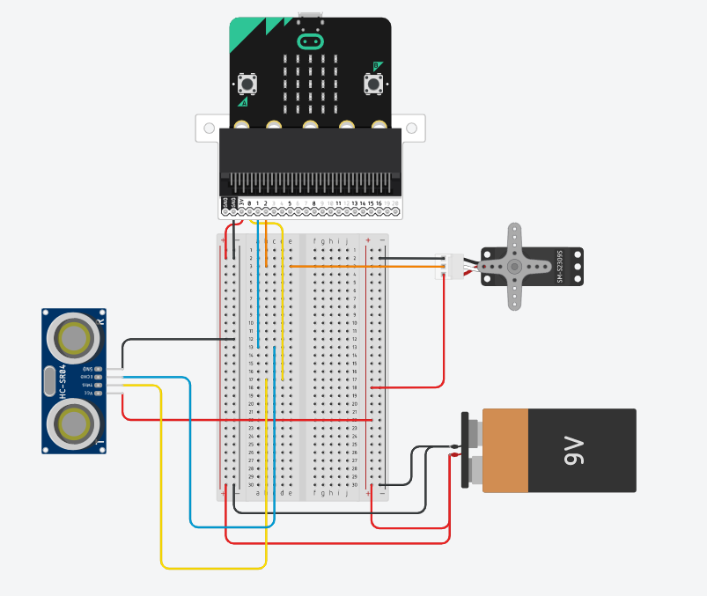
3.3V input
5V input

Slide 11
