Slide 1
NEOPIXEL LED STRIP MANUAL

Slide 2
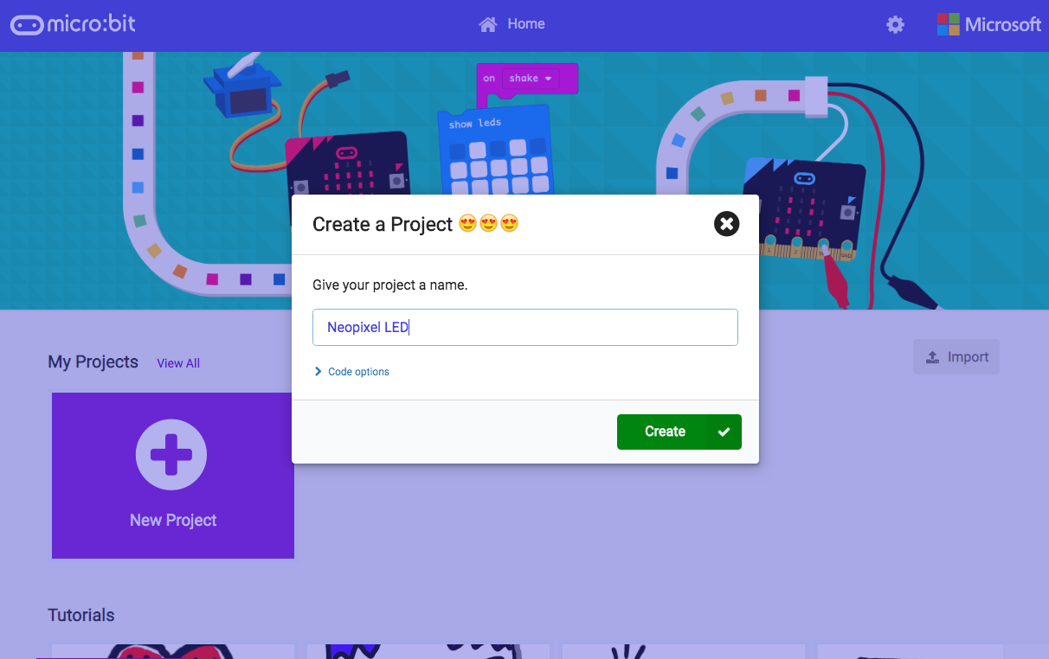
MICRO:BIT CODES
Step 1: go to https://makecode.microbit.org/
Step 2: create your micro:bit project

Slide 3
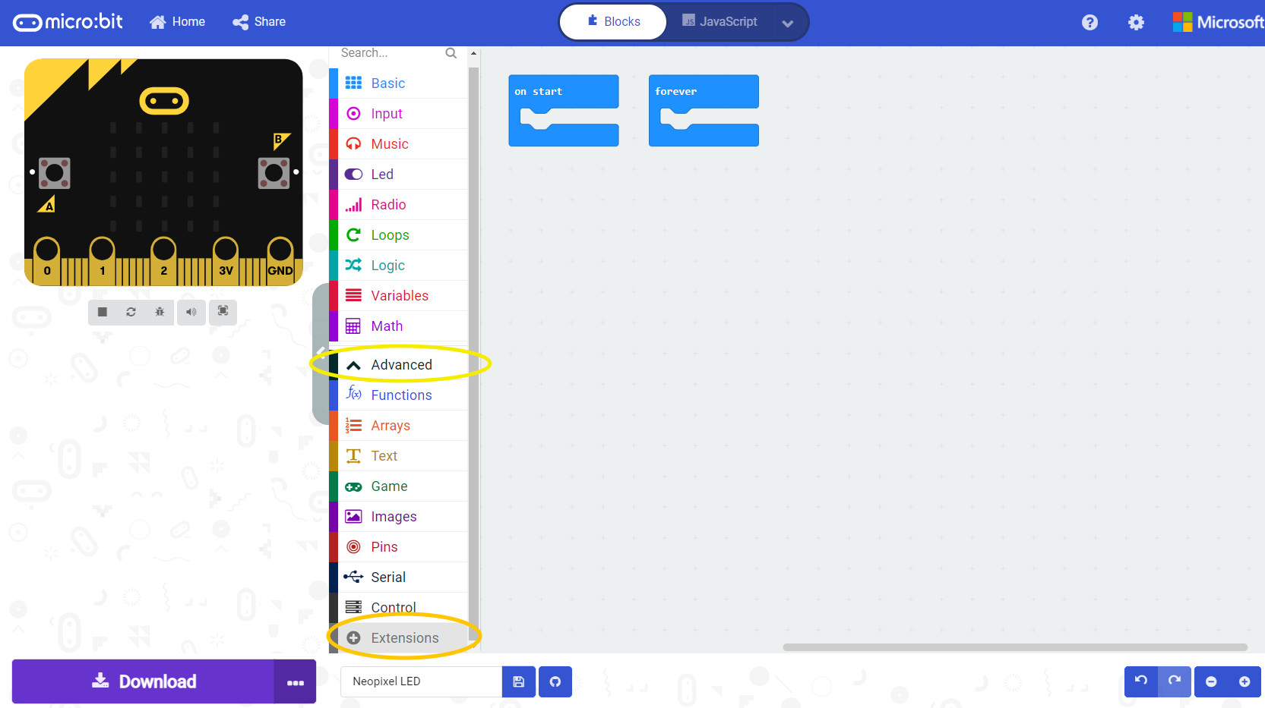
MICRO:BIT CODES
Step 3: click on “Advanced” and “Extensions” as shown below

Slide 4
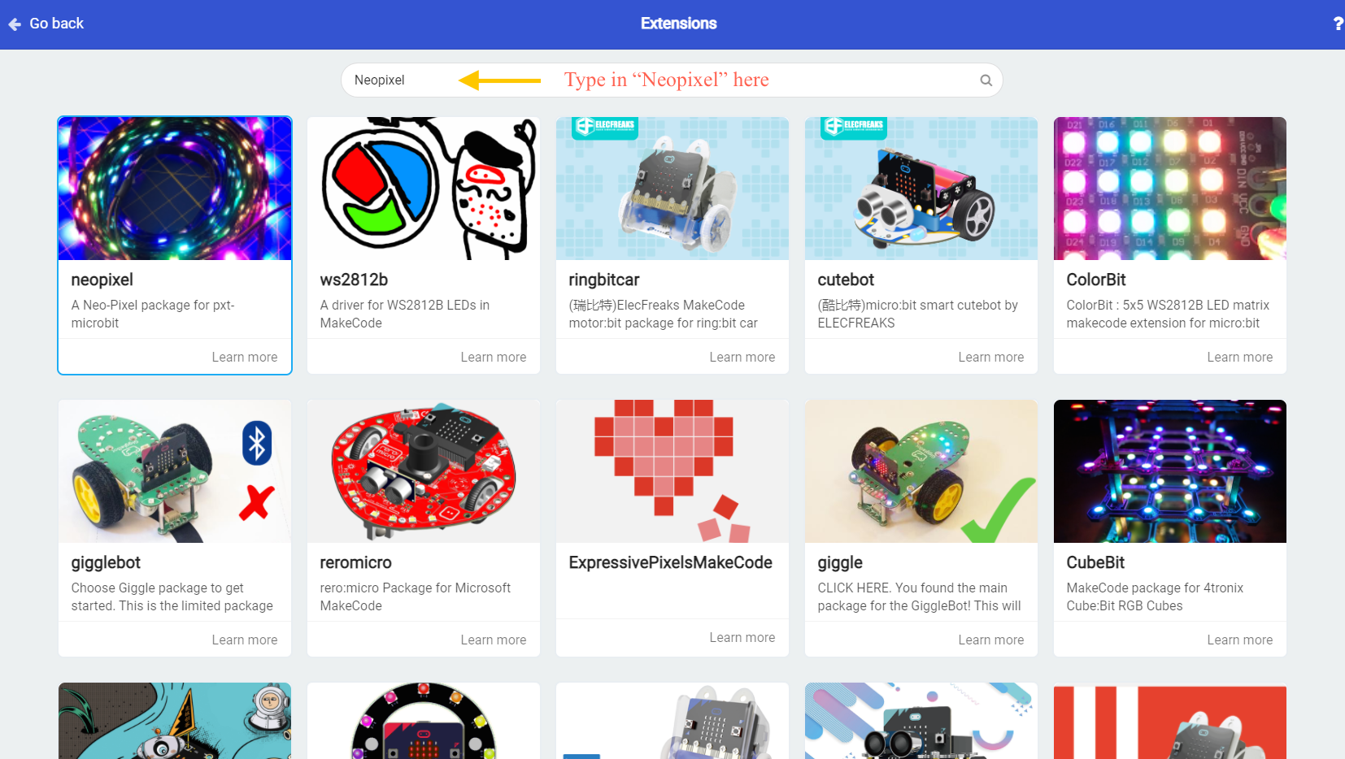
MICRO:BIT CODES

Slide 5
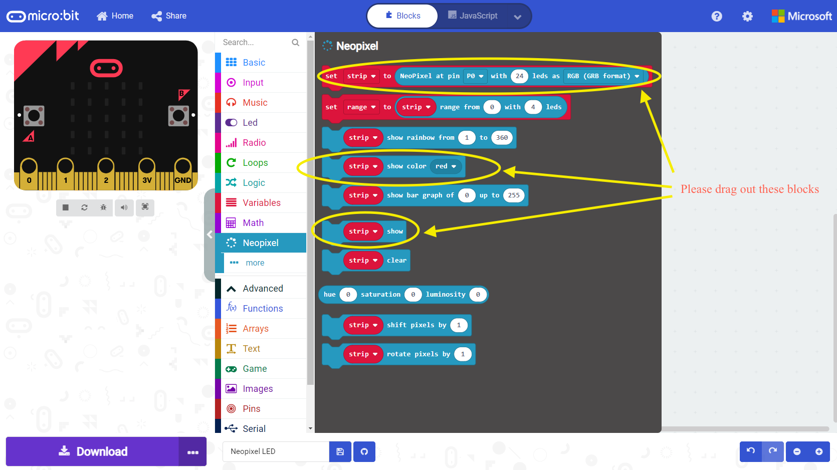
MICRO:BIT CODES

Slide 6
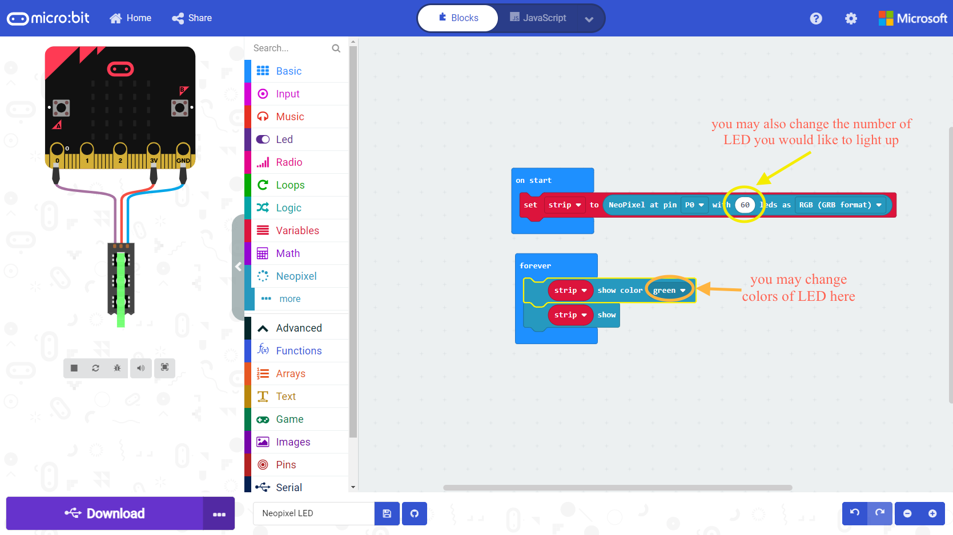
MICRO:BIT CODES

Slide 7
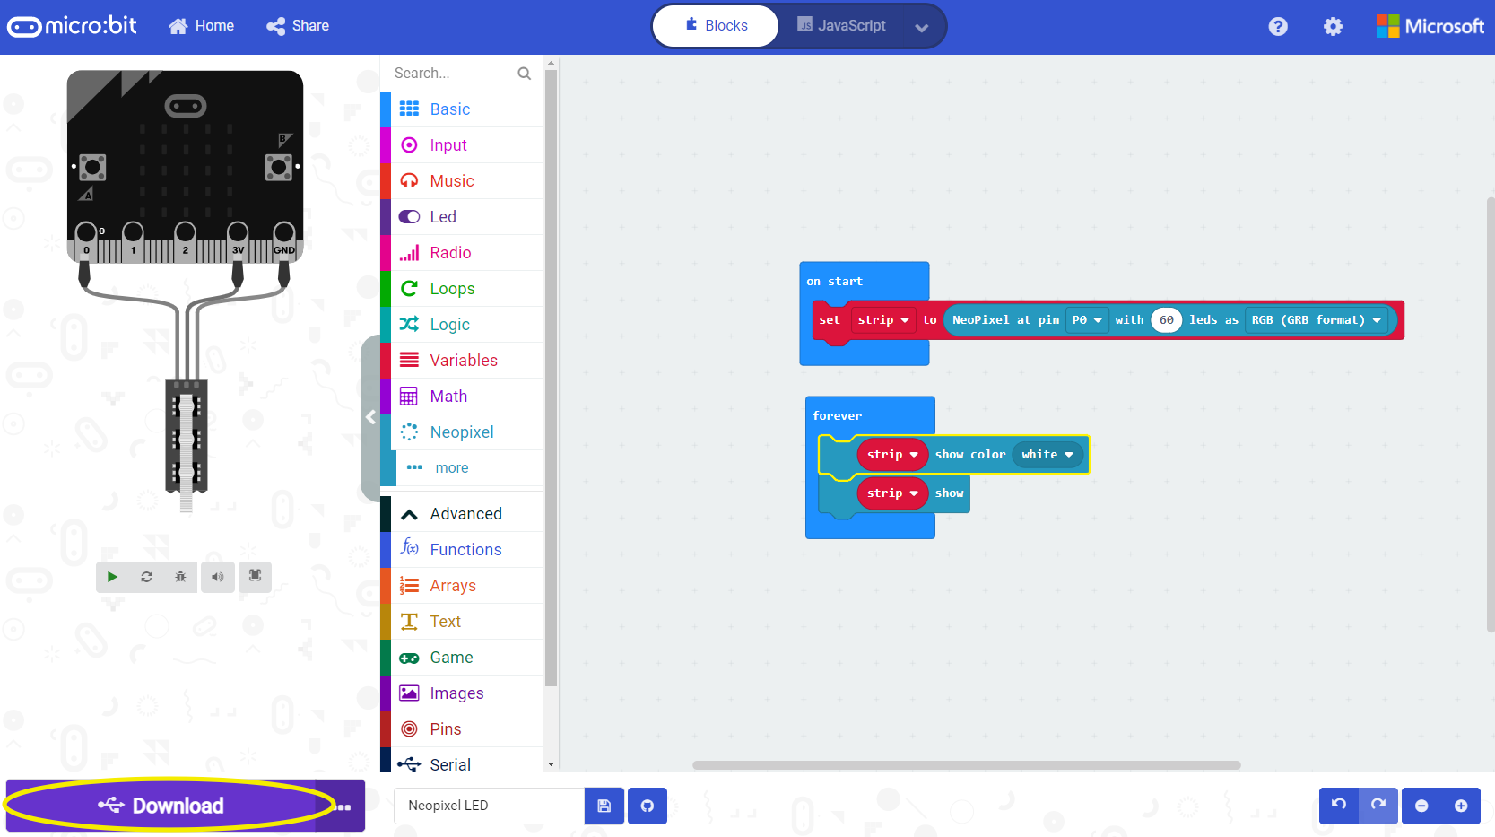
MICRO:BIT CODES
Step 4: you may download your program to micro:bit

Slide 8
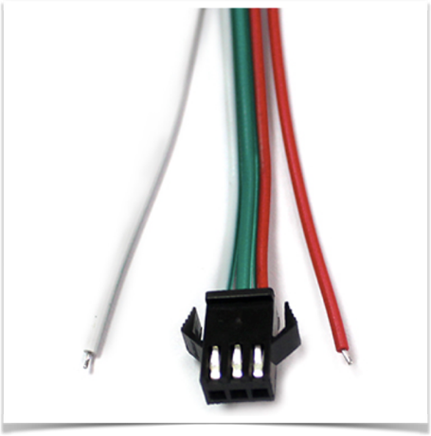
CONNECTIONS OF NEOPIXEL LED WITH MICRO:BIT
red -> 3V
green -> pin 0
white -> GND
NOTE: Please note that LED strip has to be connected to the plug as shown on the picture. LED strip will NOT work if connected on the other end of the strip

Slide 9
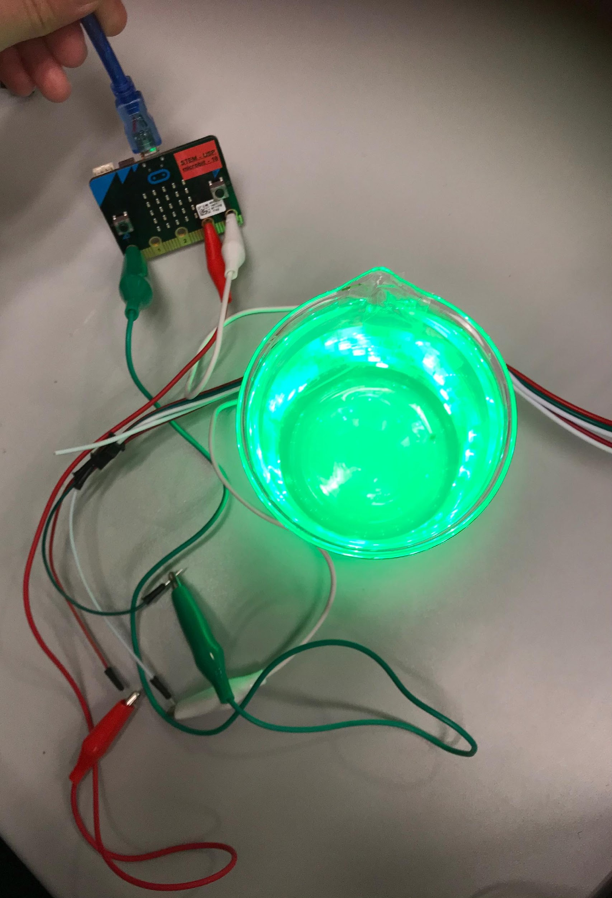
If everything is connected nicely, then…

